Slide 1

OpenShift Tutorial
TP5 - Log3000 — H2019
Armstrong Foundjem
MCIS — Laboratory

Slide 2



Let’s watch this video

Slide 3

Let’s watch this video

Slide 4

PaaS
IaaS

Slide 5

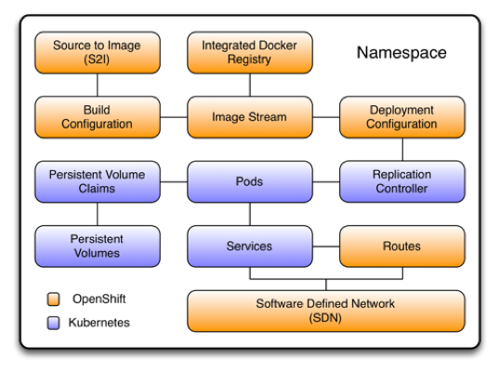


OpenShift, platform as a service (PaaS) ODK Red Hat builds on Docker and K8s.
DevOps can deliver faster with containers and Kubernetes
Focus on coding while OpenShift build, run, and scale your apps in the cloud
K8s, container as a service (CaaS) an open source project from Google

Slide 6


https://learn.openshift.com/introduction/getting-started/

Slide 8


Slide 9

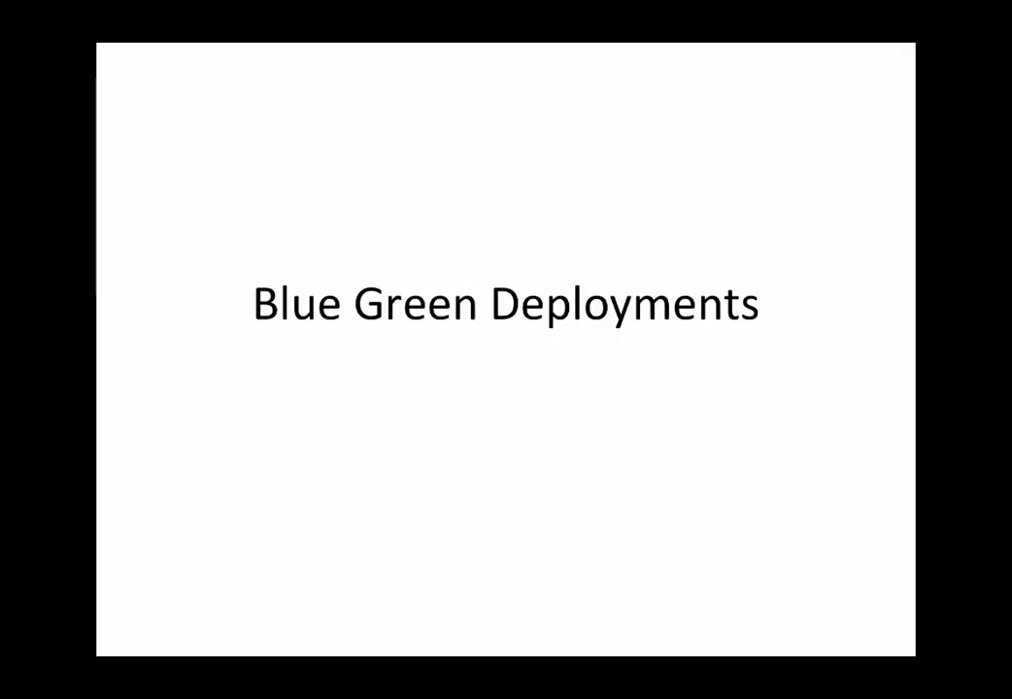
Let’s watch this video

Slide 10

https://access.redhat.com/documentation/en-us/openshift_container_platform/3.7/html/upgrading_clusters/upgrading-blue-green-deployments
https://opensource.com/article/17/5/colorful-deployments

Slide 11

Fin
Good luck!

Slide 12

Supplementary Materials for your knowledge bank only.
https://www.katacoda.com/courses/kubernetes
https://www.katacoda.com/courses/kubernetes/launch-single-node-cluster
https://kubernetes.io/docs/tutorials/kubernetes-basics/deploy-app/deploy-interactive/
https://kubernetes.io/docs/tutorials/hello-minikube/

